Slide 1
VGA Web Graphics Ivo Pisařovic
Lightning
Textures

Slide 2
Outline
Light
Shadow
Textures

Slide 3
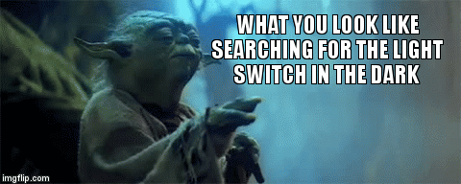
Light
Light
Shadow
Texture

Slide 4
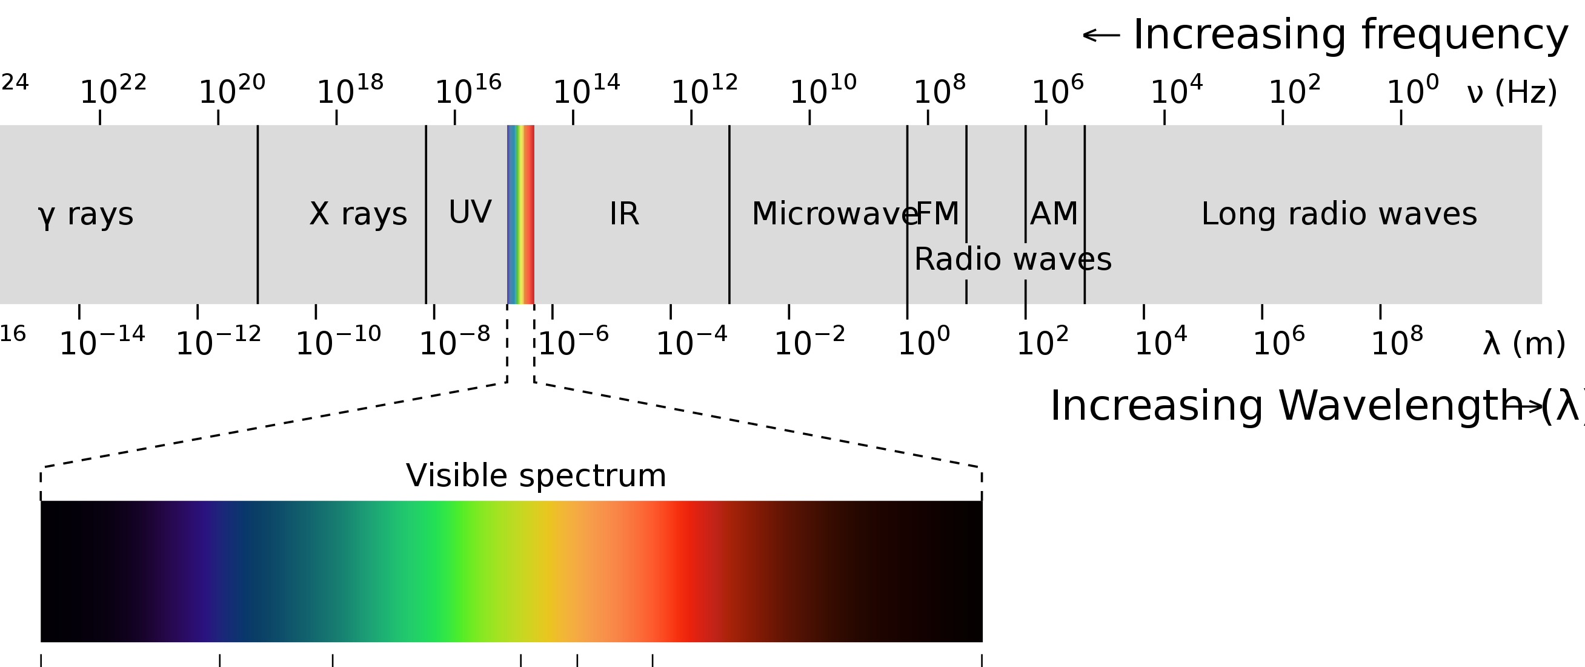
Light
Light or visible light is electromagnetic radiation that can be perceived by the human eye.
A mathematical function describing the intensity of a beam of scattered light as a function of its direction and the direction, intensity and wavelength of the incident beam. The models are physical (Torrance-Sparrow) or simplified (Phong illumination model).
https://en.wikipedia.org/wiki/Light
https://en.wikipedia.org/wiki/Light#/media/File:EM_spectrum.svg

Slide 5
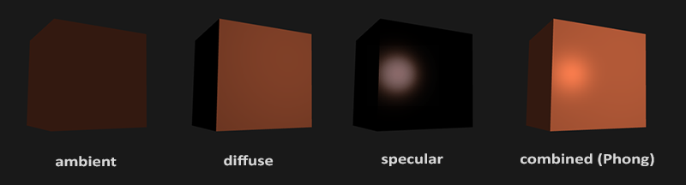
Light Components
http://hucoco.com/2018/07/09/Lighting_and_Materials/

Slide 6
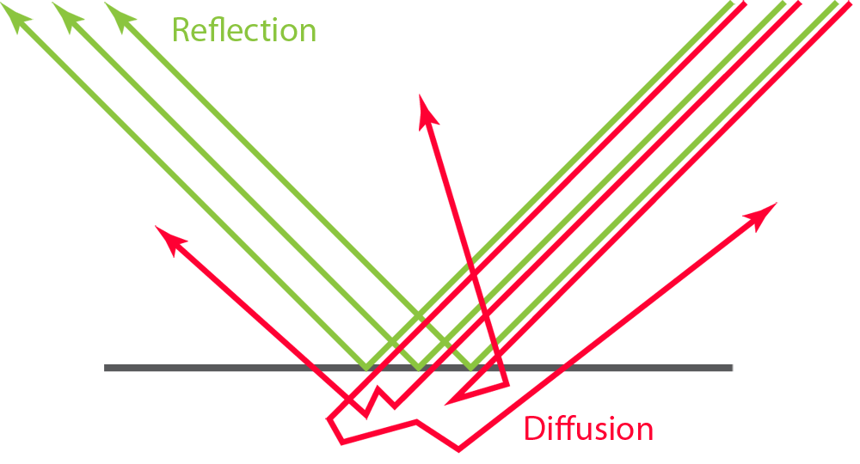
https://marmoset.co/posts/basic-theory-of-physically-based-rendering/

Slide 7
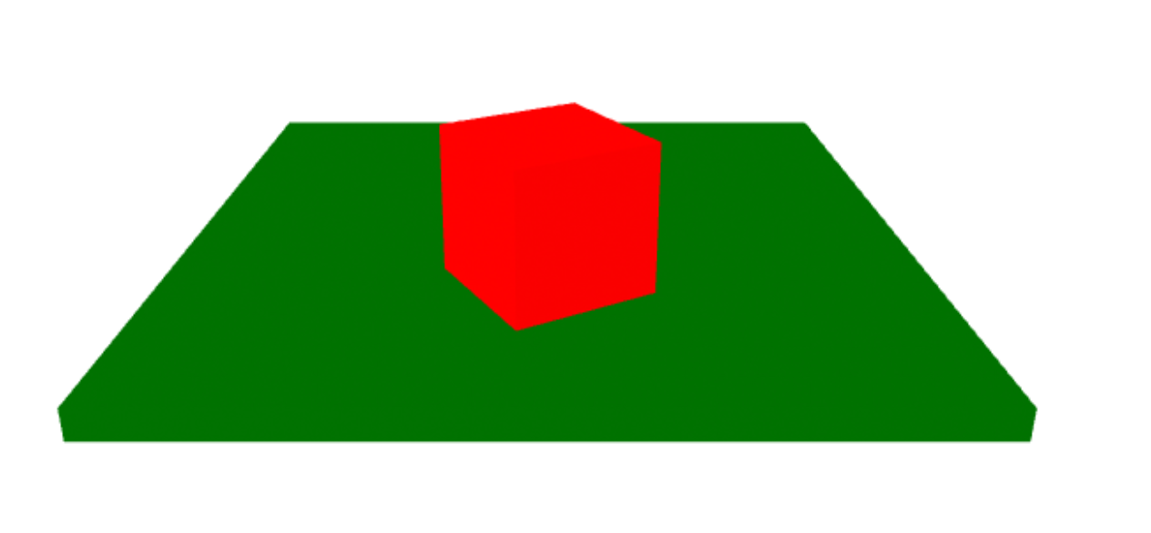
Light Components / Ambient
The very basic type and the most simple one
Is present in all scenes as nothing is completely dark
Simple to calculate but not realistic (use it only with low intensity)
float ambientStrength = 0.1;
vec3 ambient = ambientStrength * lightColor;
vec3 result = ambient * objectColor;
FragColor = vec4(result, 1.0);

Slide 8
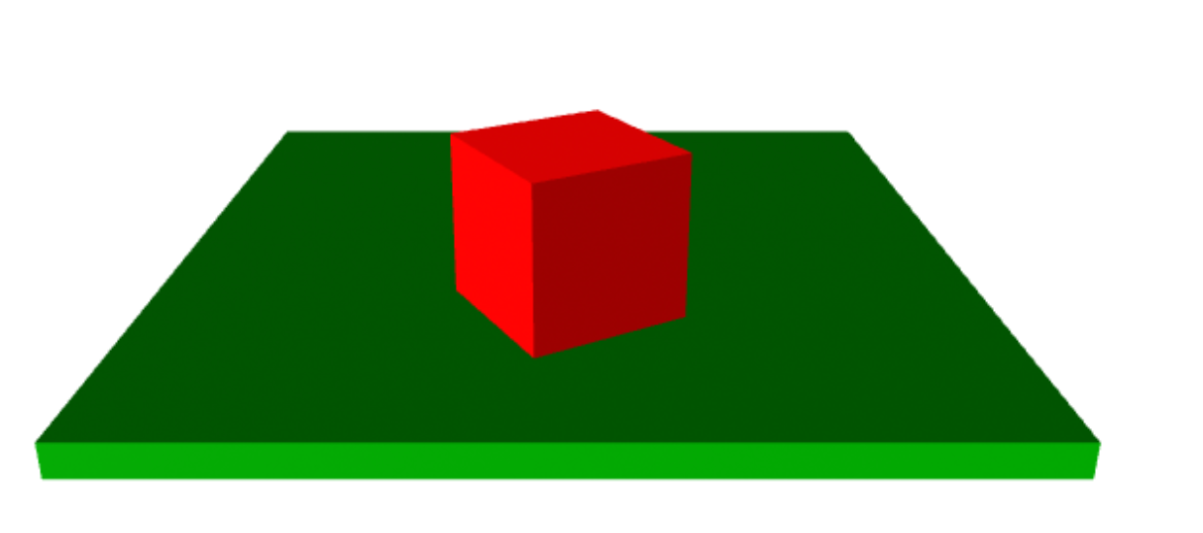
Light Components / Diffuse
Comes from one direction
Reflects to all directions
Plastic feeling
Light goes under the surface and is scattered
The scattering is often so uniformly chaotic that it can be said to appear the same from all directions
float diff = max(dot(norm, lightDir), 0.0);
vec3 diffuse = diff * lightColor;
vec3 result = diffuse * objectColor;
FragColor = vec4(result, 1.0);

Slide 9
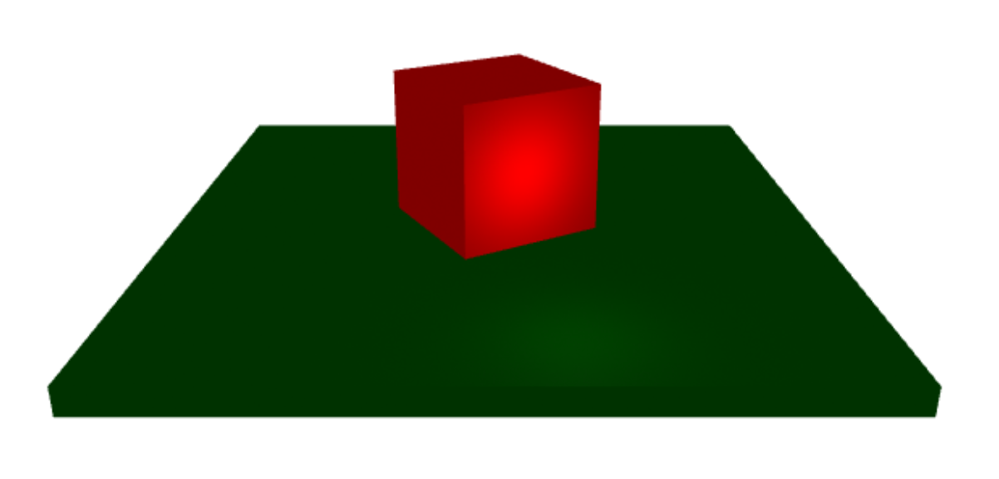
Light Components / Specular
Comes from one direction
Reflects to one direction
Metalic feeling
The visible intensity is determined by the angle between the eye and the direct reflected ray.
float specularStrength = 0.5;
vec3 viewDir = normalize(viewPos - FragPos);
vec3 reflectDir = reflect(-lightDir, norm);
float spec = pow(max(dot(viewDir, reflectDir), 0.0), 32);
vec3 specular = specularStrength * spec * lightColor;
vec3 result = specular * objectColor;
FragColor = vec4(result, 1.0);

Slide 10
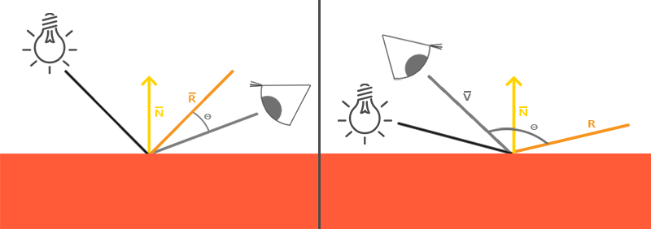
Light Components / Specular
http://hucoco.com/2018/07/09/Lighting_and_Materials/

Slide 11

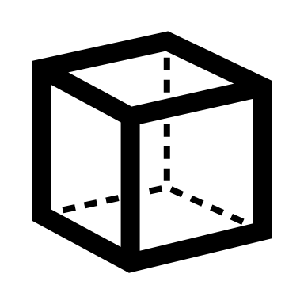
Abstraction
Light
Material
A light is an entity in your 3D scene with a position and direction (not all lights have direction).
Material is defining how is incoming light transformed into the final visible color of an object.

Slide 12
Material
Material is a set of properties of an object that define how the object surface affects the incoming light rays.
Predefined materials include shaders that use the following standard lighting models = calculating the final color of a pixel based on all light components.
Flat
Phong
Blinn-Phong
Lambert
Physically based rendering (PBR)

Slide 13
Standard Shaders / Flat
Not affected by any lights
All colors rendered at 100% intensity, no shades or reflections
No computations, super fast
Looks very unrealistic
Suitable for UI elements or small objects

Slide 14
Standard Shaders / Phong
Requires more fine tuning to achieve realistic look compared to Blinn-Phong or PBR
Inexpensive and fast
Ambient + diffuse + specular component makes the final intensity
Control parameters:
shininess,
reflectivity
A better but less effective alternative to Phong is Blinn-Phong

Slide 15
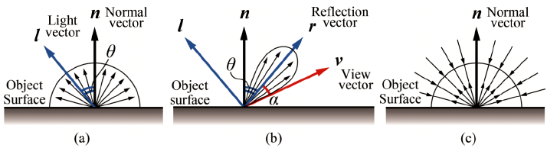
float ambientStrength = 0.1;
vec3 ambient = ambientStrength * lightColor;
vec3 norm = normalize(Normal);
vec3 lightDir = normalize(lightPos - FragPos);
float diff = max(dot(norm, lightDir), 0.0);
vec3 diffuse = diff * lightColor;
vec3 viewDir = normalize(viewPos - FragPos);
vec3 reflectDir = reflect(-lightDir, norm);
float spec = pow(max(dot(viewDir, reflectDir), 0.0), 32);
vec3 specular = specularStrength * spec * lightColor;
vec3 result = (ambient + diffuse + specular) * objectColor;
FragColor = vec4(result, 1.0);

Slide 16
Standard Shaders / Physically Based Rendering (PBR)
Realistic
Instead of approximations it uses a physically correct model
Most computationally expensive
Standard in A-FRAME, Unity, Unreal Engine
Less configuration than Phong, a lot of is calculated automatically
Influencing the object appearance using two main parameters:
Reflectivity/metalness (odrazivost)
Roughness/gloss (lesk)
https://marmoset.co/posts/basic-theory-of-physically-based-rendering/
Disney again: https://media.disneyanimation.com/uploads/production/publication_asset/48/asset/s2012_pbs_disney_brdf_notes_v3.pdf

Slide 17
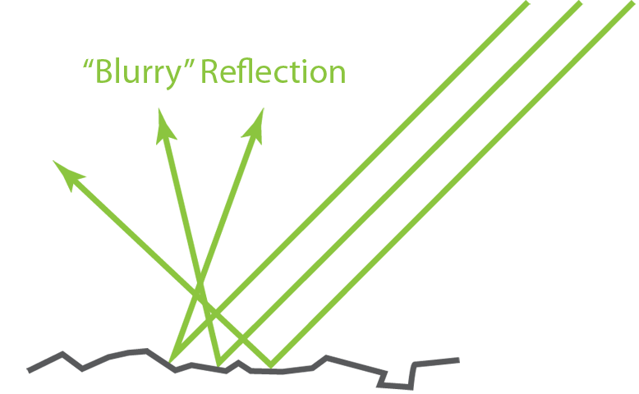
https://marmoset.co/posts/basic-theory-of-physically-based-rendering/

Slide 18
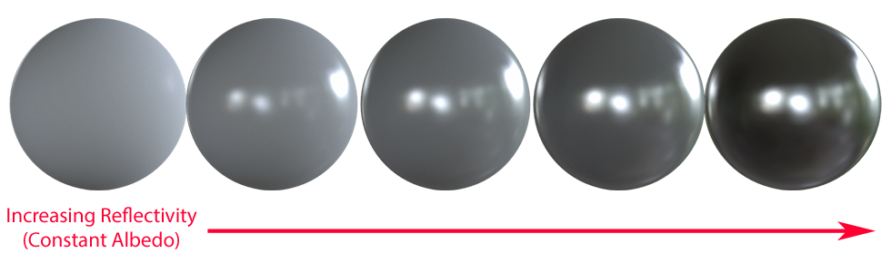
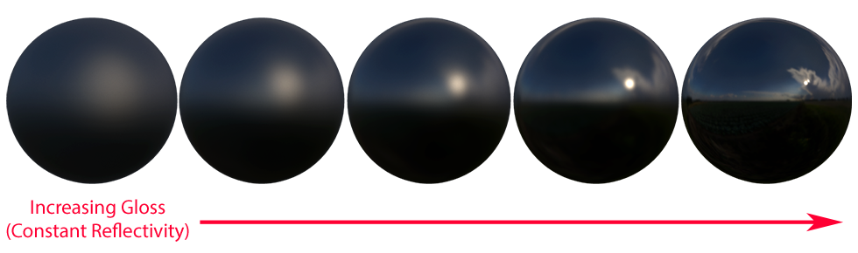
https://marmoset.co/posts/basic-theory-of-physically-based-rendering/

Slide 19
Standard Shaders / Physically Based Rendering (PBR)
Polished metal, like stainless steel fence:
reflectivity: high, gloss: high
Matte plastic LEGO brick:
reflectivity: low, gloss: low
Vinyl floor:
reflectivity: low-moderate, gloss: moderate
Liquid water:
reflectivity: low-moderate, gloss: moderate-high
Solid ice:
reflectivity: moderate-high, gloss: high

Slide 20
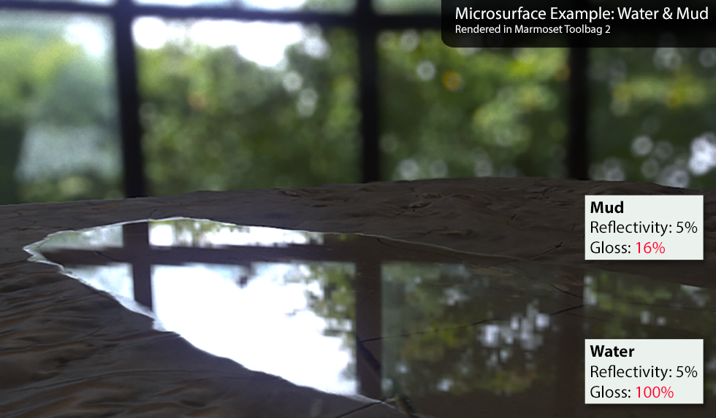
Standard Shaders / Physically Based Rendering (PBR)
https://marmoset.co/posts/basic-theory-of-physically-based-rendering/
Notes:
(reflectivity 5% is F₀, or base reflectance at normal (head-on) angles and thanks to the Fresnel effect, this small base reflectivity ramps up to nearly 100% at glancing angles, giving that mirror-like look around the edges)

Slide 21
Light
Light is an entity in the scene defining light rays emitted into the scene that are processed by materials of objects.
Ambient
Directional
Hemisphere
Point
Spot
Probe

Slide 22
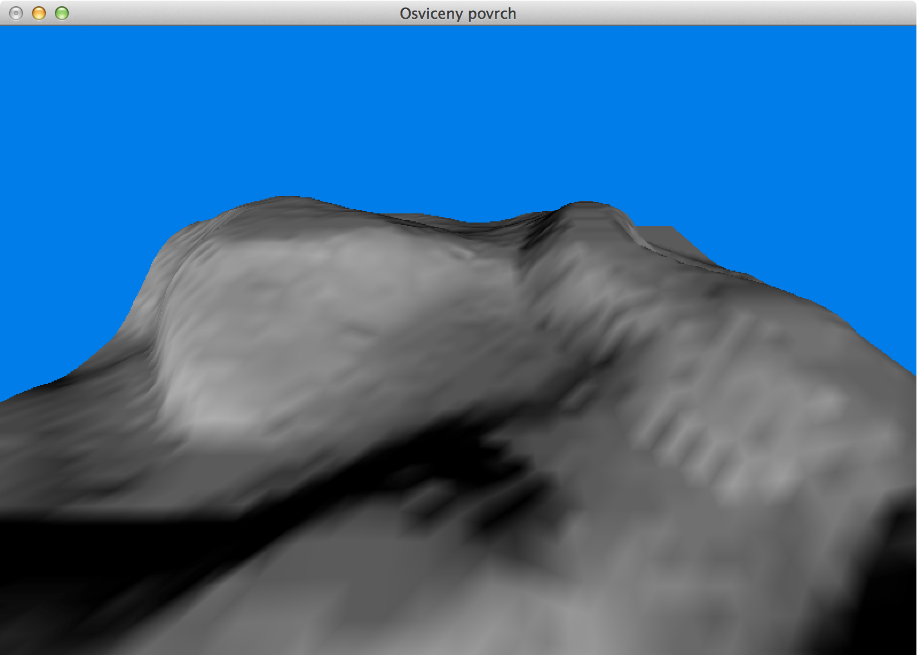
Lights / Directional
Position is irrelevant
Always positioned very far away (like [–9999, 9999, 9999])
Only the direction it targets matter
Simulates light from a distant light source like Sun
No decay of light rays on the way = constant ray intensity in the whole scene
Effective for casting shadows

Slide 23
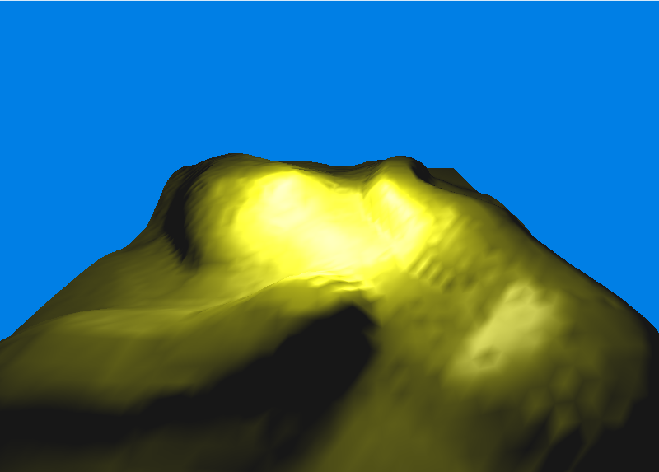
Lights / Point
Has a specific position
Has a decay over distance = decreasing intensity further away from the light
E.g. a bulb or street light

Slide 24
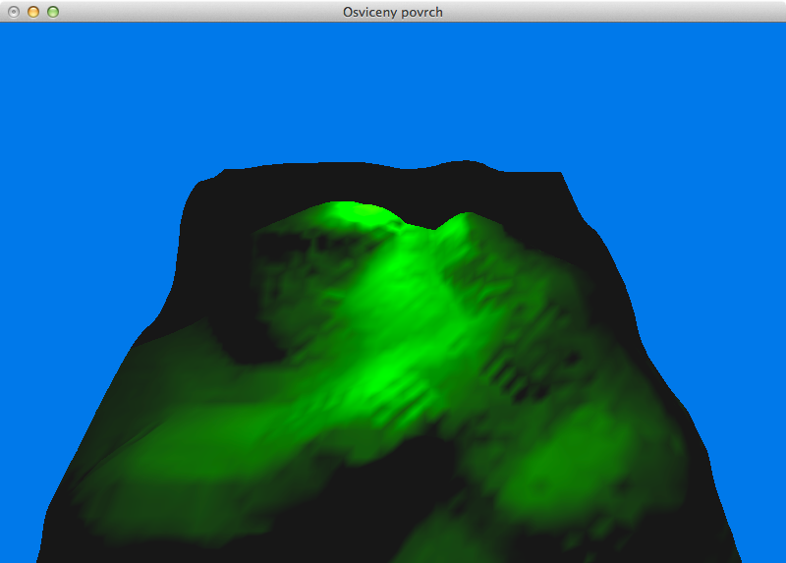
Lights / Spot
Like the point light with a shield defined by a cutoff angle
In contrast to point light, spot light shines only in one direction
Also has a decay over distance
E.g. a theatre reflector, a torch or a desk lamp

Slide 25
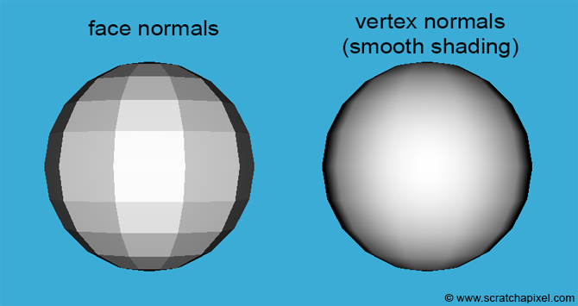
Normals
Normals are vectors attached to vertices of an object
Normal vector is related to the surrounding faces
Therefore, one vertex may have multiple normal vectors
Normals may improve lightning if set correctly because automatic calculations of normal is not always optimal

Slide 26
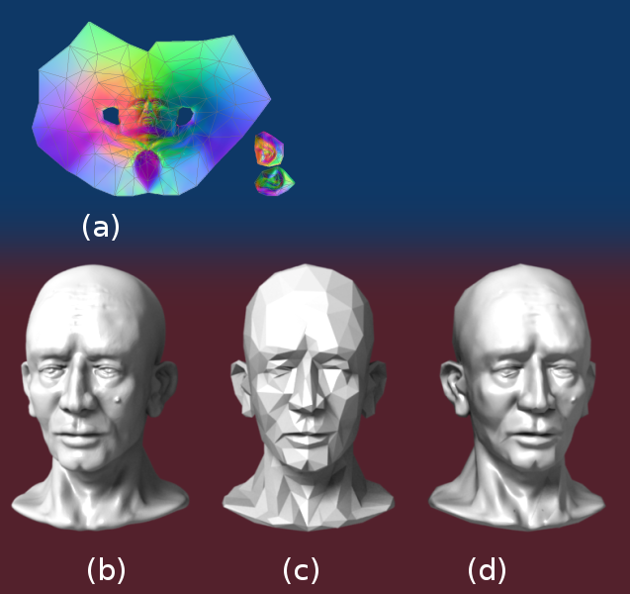
Normal maps
Simplified model (768 faces)
Applied normal map to smoothen simplified model (768 faces)
Normal map
Original model (78642 faces)
https://en.wikipedia.org/wiki/Normal_mapping

Slide 27
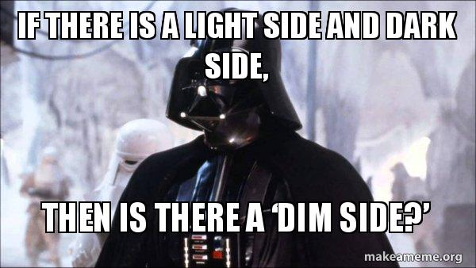
Shadow
Light
Shadow
Texture

Slide 28
Shadow
Ambient light does not support shadows.
Light types that support shadows: point, spot, directional.
Shadows are computationally expensive, cannot be turned on for everything similarly to physics.
Possible implementations:
“hardcode” shadows into textures and save resources
Turn on shadow casting only for selected lights and objects
Optimize “shadow camera” to decrease shadow resolution and region of scene to apply shadows in.
May take time to configure realistic and effective shadows.

Slide 29
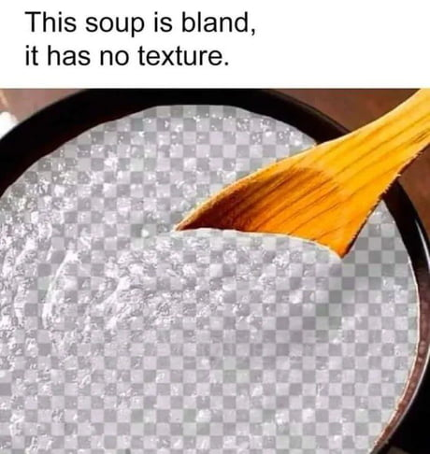
Texture
Light
Shadow
Texture

Slide 30
Texture
The texture is matrix of natural numbers for OpenGL API.
Textures are stored on a graphics card in a similar way the vertices are.
The data are store in a texture objects that contains the data, description of structure etc.
The shaders then access the object and read the data.
A single object may combine different textures – multitexturing.

Slide 31
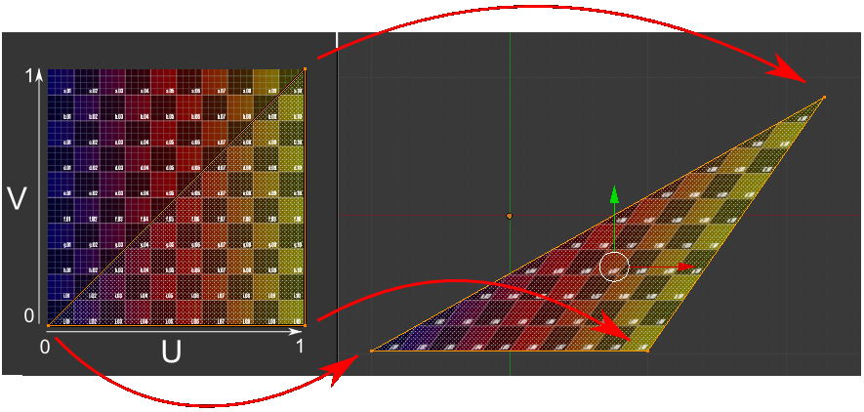
Attaching textures to objects
2D texture is attached using UV coordinates on <0, 1> interval.
Usually, 2D texture has [0, 0] coordinates in bottom left corner and
[1, 1] in top right corner. If we use higher number, the texture repeats (2 = 2×).
The coordinates are described using letters s, t, r a q.
https://www.opengl-tutorial.org/

Slide 32
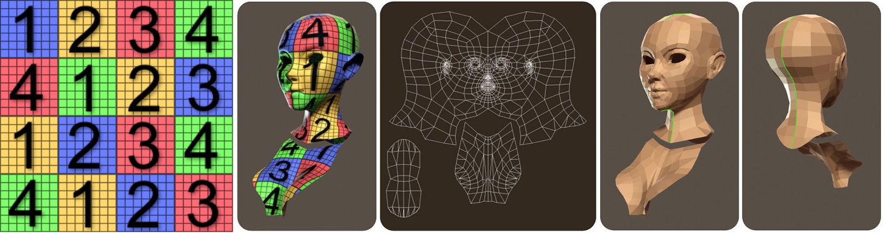
Attaching textures to objects
https://cgi.tutsplus.com/articles/ game-character-creation-series-kila-chapter-3-uv-mapping--cg-26754

Slide 33
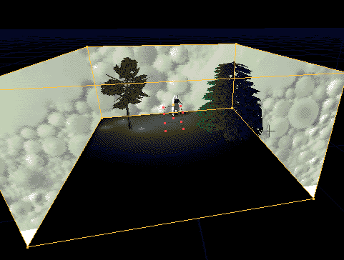
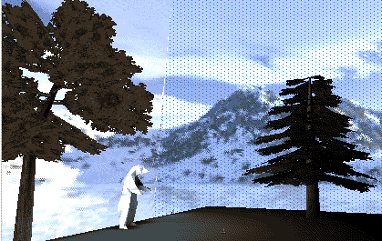
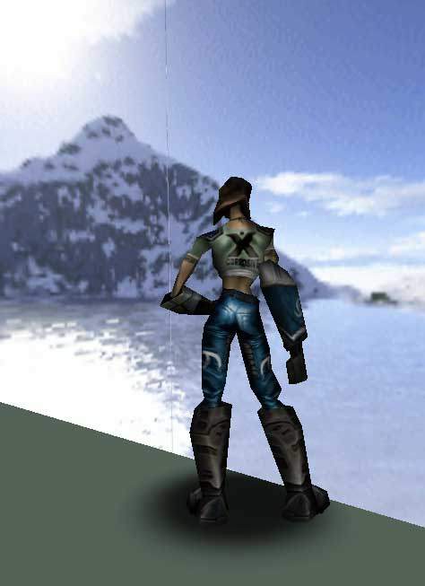
Skybox Texture
For many games, we must create an infinite background (e.g. in Doom).
This background is represented by a cube with textures called Skybox.
The observer is inside the cube.
We never apply rotation or translation on this cube!
http://creativegames.org.uk/modules/Game_Design/units/unit10.htm

Slide 34
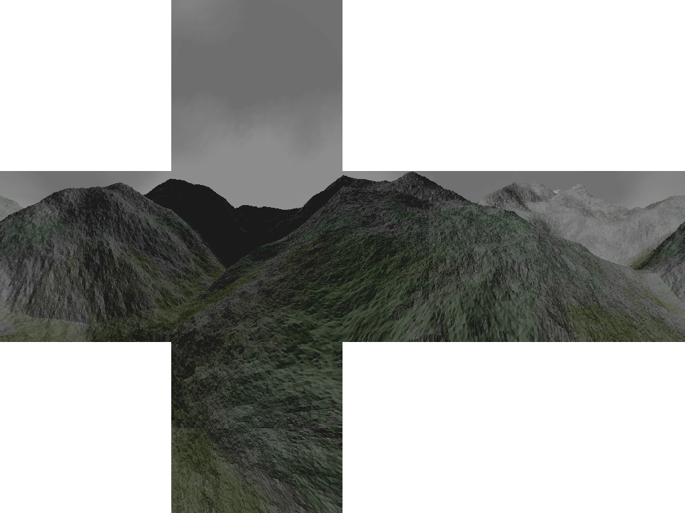
http://scmapdb.com/skybox:doom1

Slide 35
Environmental Mapping
Environmental mapping = mapping of surrounding environment on rendered object.
We can simulate (reflection) or (refraction).
There are two possible implementations: sphere map and cube map.
Sphere maps is a technique developed by Blinn and Newell.
The source image is a spherical projection of surrounding on a single texture.
It’s not frequently used because of complex preparation.

Slide 36
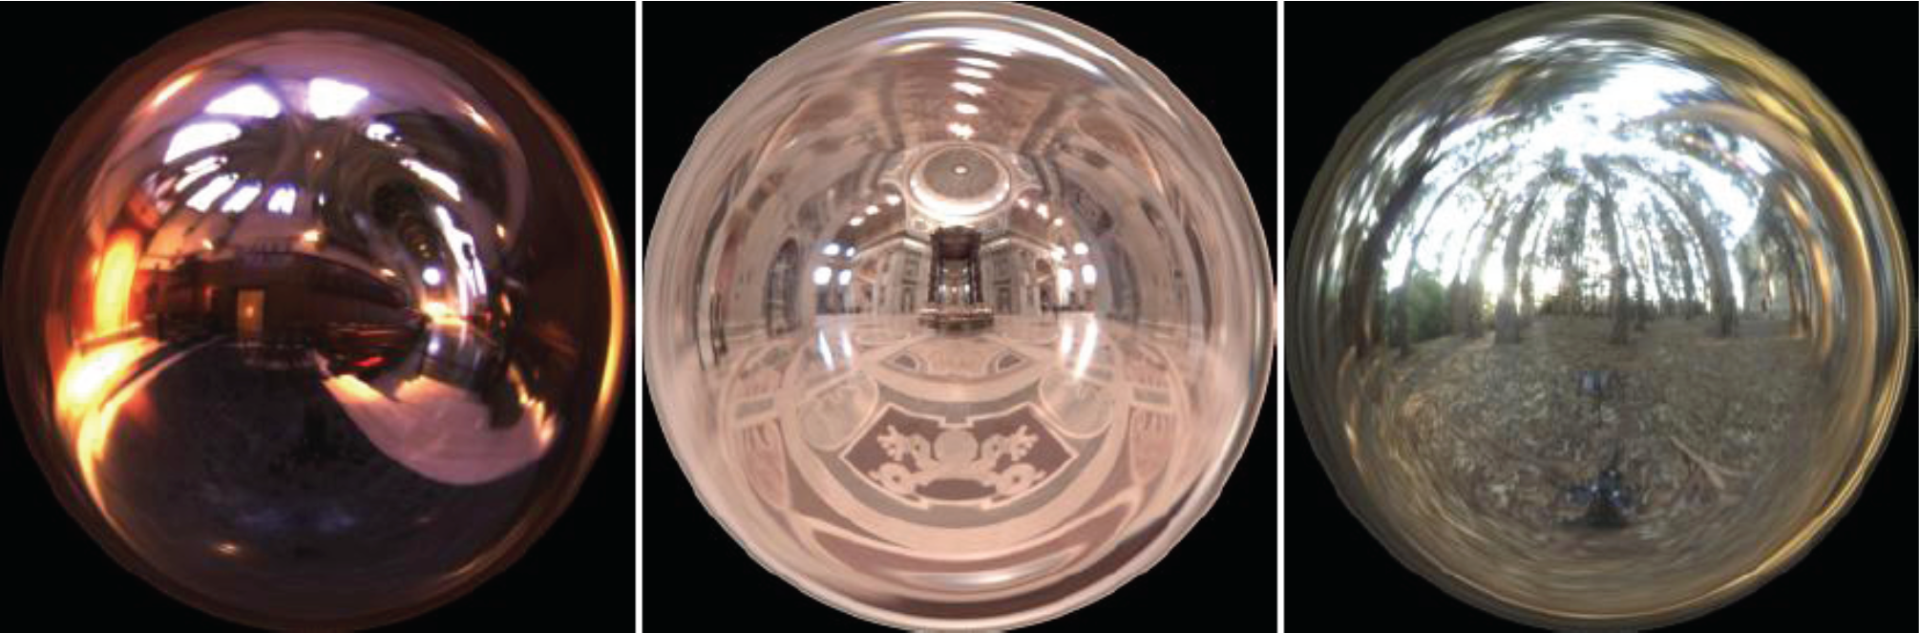
Environmental Mapping / Sphere map
http://www.debevec.org

Slide 37
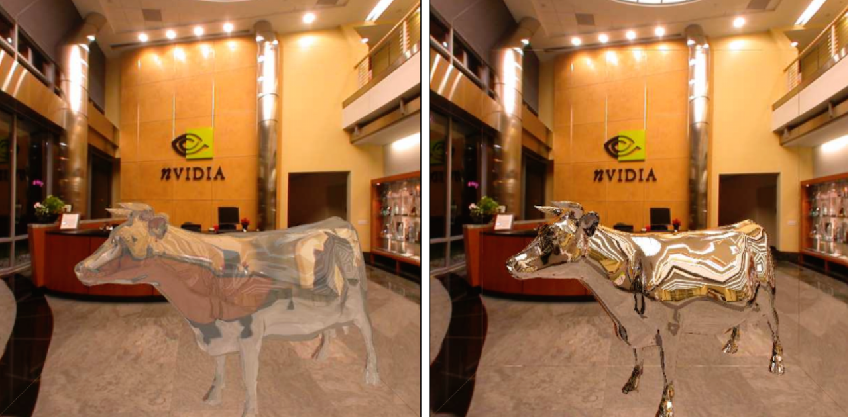
Environmental Mapping / Refraction and reflection of light
http://www.nvidia.com

Slide 38
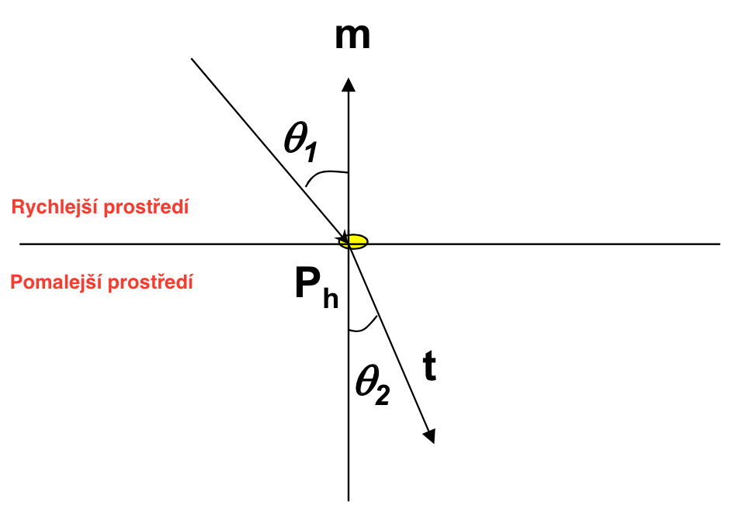
Refraction
Transition from faster medium to slower medium: vector goes to the normal.
Transition from slower medium to faster medium: vector goes from the normal.
The c1 and c2 ratio is important. Usually it is calculated like vacuum/medium ratio.
Air: 99.97 %
Glass: 52.2 % to 59 %
Water: 75.19 %
Sapphire: 56.50 %
Diamond: 41.33 %

Slide 39
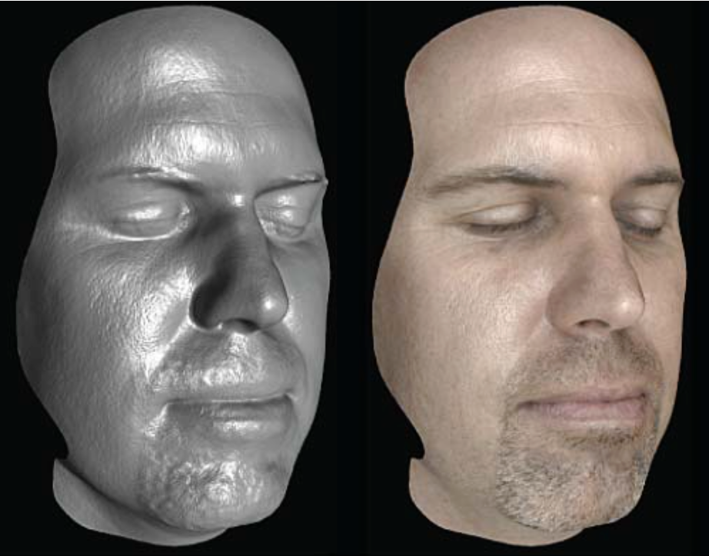
Advanced Textures
Reflection mapping
E. Agu: Computer Graphics (CS 543) Lecture 9

Slide 40
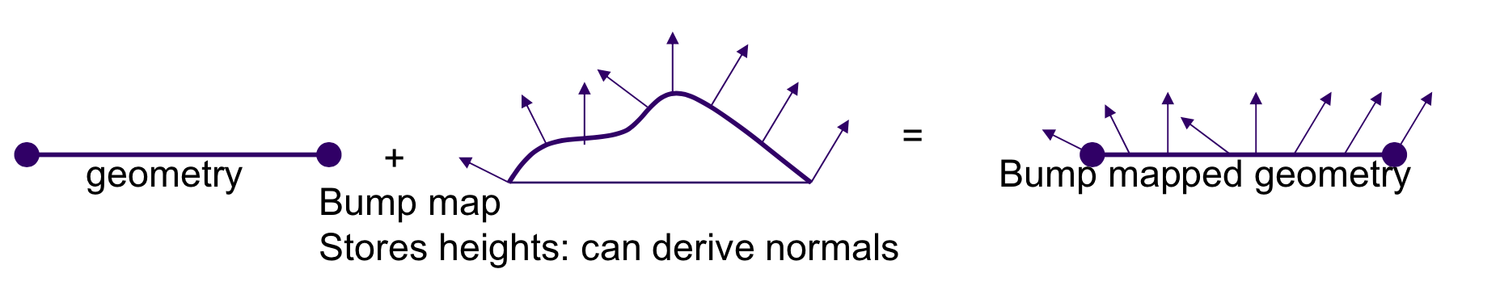
Advanced Textures
Bump mapping
• Invented by Blinn. • We modify the normal using a value in a texture. • Further, we calculate lighting using this normal. • Much more efficient than store the information in the geometry.
E. Agu: Computer Graphics (CS 543) Lecture 9

Slide 41
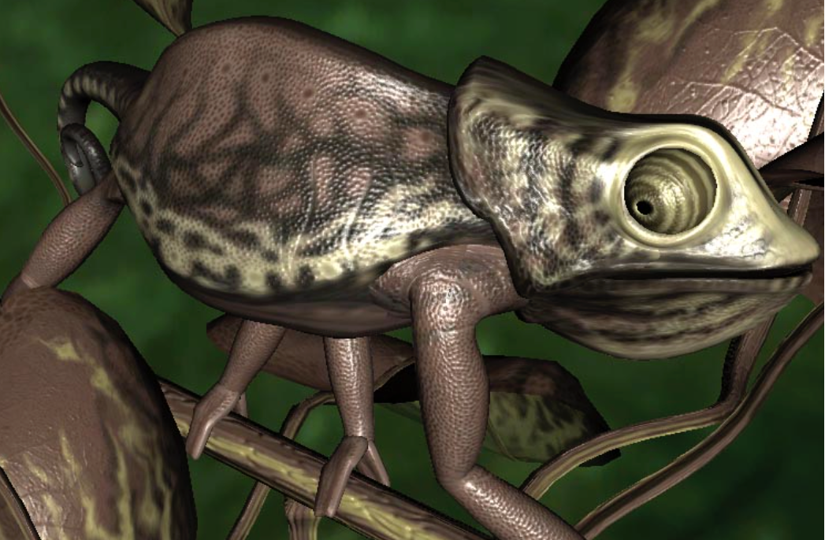
Advanced Textures
Bump mapping
E. Agu: Computer Graphics (CS 543) Lecture 9

Slide 42
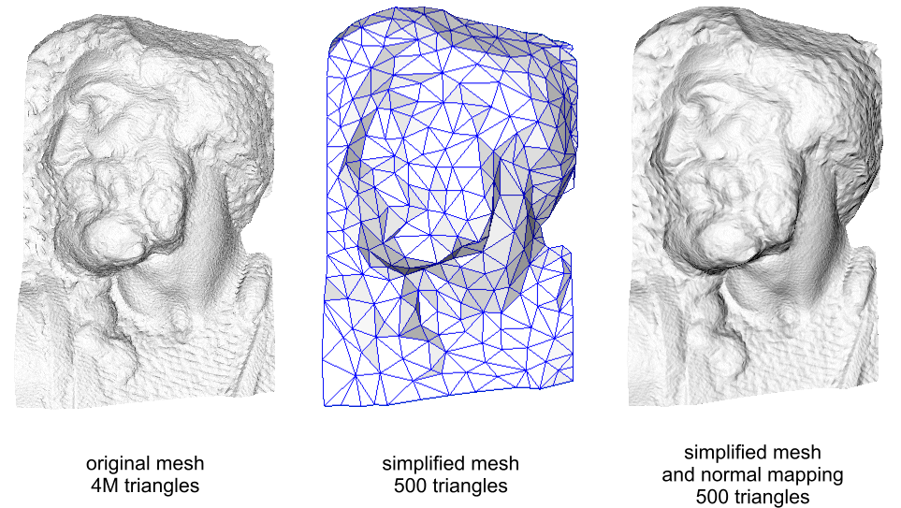
Advanced Textures
Normal mapping
Similar to bump mapping, but bump map can be applied on different objects.
Normal map is for particular object – it contains values of normals.
Wikipedie

Slide 43
Advanced Textures
Alpha & transparency
So called blending allows to create translucent objects.
We can also set alpha channel in fragment shader:
gl_FragColor = vec4(color.r, color.g, color.b, 0.5)
Or skip a pixel completely:
outColor = texture(texture0, texCoord0.st);
if (outColor.a < 0.1) {
discard;
} else {
gl_FragColor = outColor
}

Slide 44
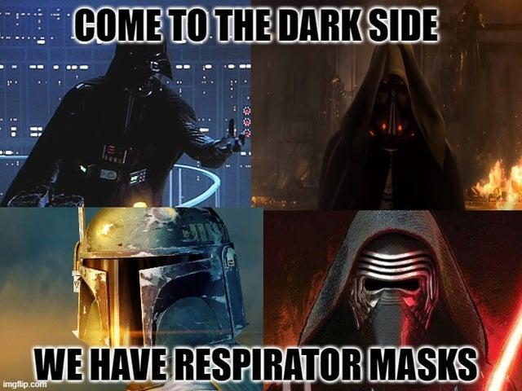

Slide 45
Reference
https://learnopengl.com/Lighting/Basic-Lighting
https://marmoset.co/posts/basic-theory-of-physically-based-rendering/

